Slide 1
Strategic Arrangement
Leadership/Programs/Space/Budget

Slide 2
Prayer
Almighty God, you sent your Son Jesus Christ to reconcile the world to yourself: We praise and bless you for those whom you have sent in the power of the Spirit to preach the Gospel to all nations. We thank you that in all parts of the earth a community of love has been gathered together by their prayers and labors, and that in every place your servants call upon your Name; for the kingdom and the power and the glory are yours for ever. Amen.

Slide 3
Bible study
Acts 13:44-47
The next sabbath almost the whole city gathered to hear the word of the Lord. ⁴⁵But when the Jews saw the crowds, they were filled with jealousy; and blaspheming, they contradicted what was spoken by Paul. ⁴⁶Then both Paul and Barnabas spoke out boldly, saying, ‘It was necessary that the word of God should be spoken first to you. Since you reject it and judge yourselves to be unworthy of eternal life, we are now turning to the Gentiles. ⁴⁷For so the Lord has commanded us, saying,
“I have set you to be a light for the Gentiles,
so that you may bring salvation to the ends of the earth.” ’

Slide 4
Bible study
What is the starting point?
What is our starting point?
What is the fear?
What is our fear?
What is the light?
What is our light?

Slide 5
The Church
What does the church have to offer to the world?

Slide 6
The Church
Why is church vitality important?

Slide 7
The Church
What can we do, working with Jesus, to support the church?
Notes:
Not all the answers

Slide 8
John Mennell
I get my own slide !!!!!!
Rector – St. Luke’s Montclair, NJ 2006-Present
Vicar? – Holy Trinity, West Orange 2013
Assistant – St. Michael’s NYC 2003-2006
GTS 2005
Notre Dame 1987
Lanai Road Elementary 1976

Slide 9
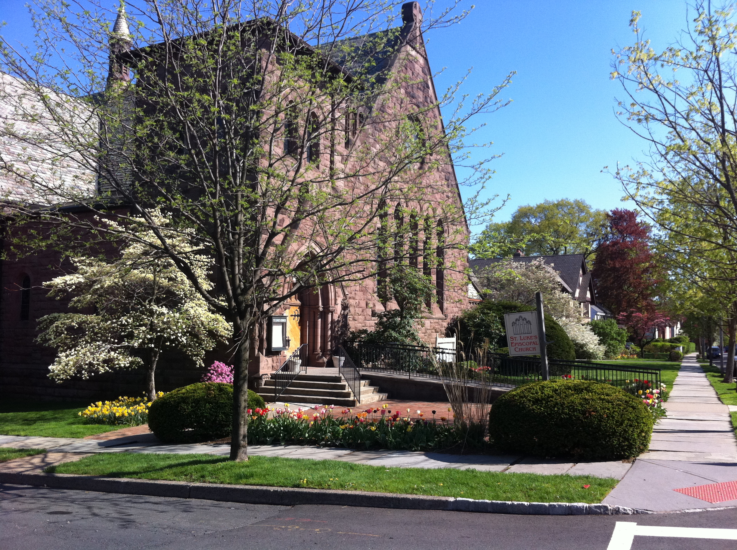
St. Luke’s Montclair
Joyfully seeking and serving Christ
Average Sunday Attendance 220
2015 Budget $851,000
Major Outreach Ministry – Toni’s Kitchen
Diverse

Slide 10
Holy Trinity
Average Sunday Attendance 45
2015 Budget $111,000
Major Outreach Ministry – Food Pantry
Increasingly Hispanic Neighborhood

Slide 11
Diocese of Newark
104 103 102 Congregations
Average Sunday Attendance declines 1-2% Year
Median ASA – 58
Median Membership 153
Median Plate & Pledge - $110,718
2015 Budget $2,500,000

Slide 12
Diocese of Newark

Slide 13
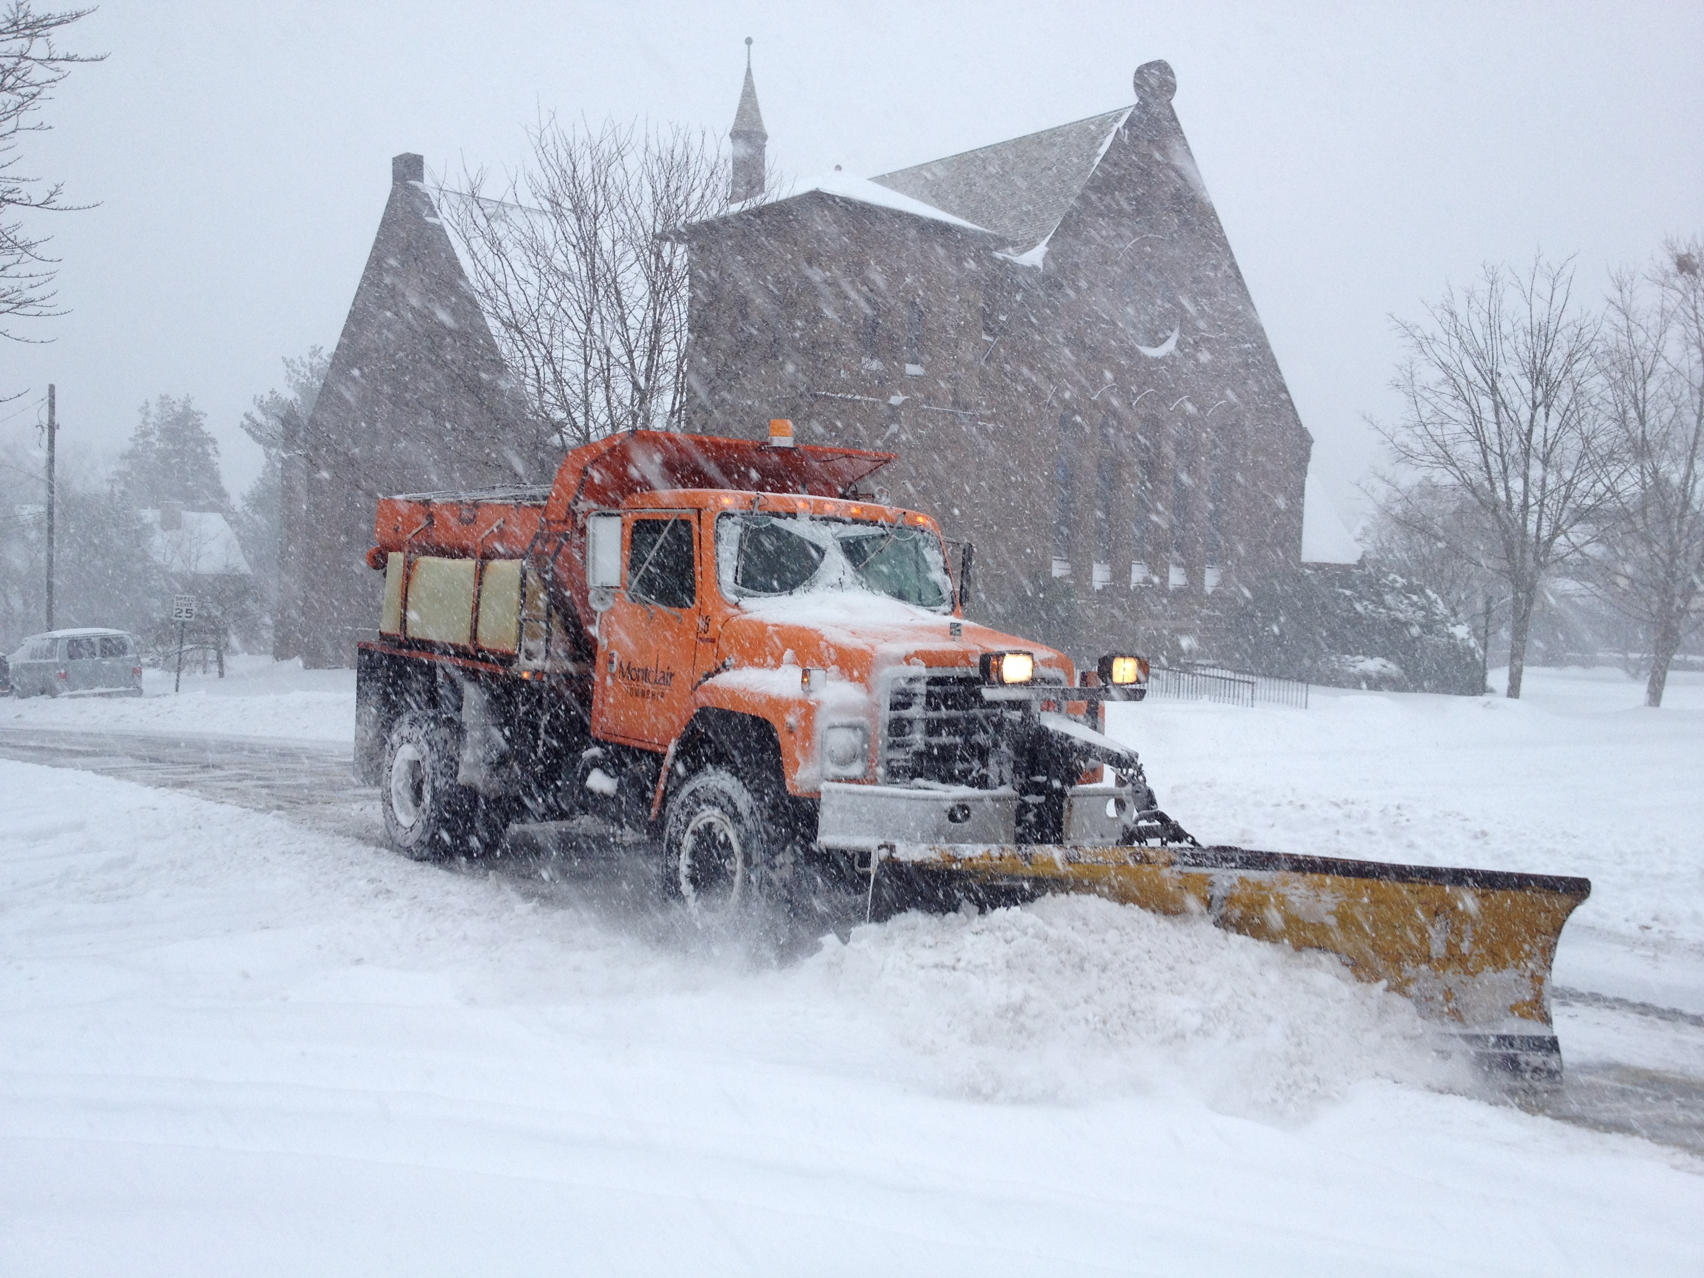
Steady Growth?
In my tenure at St. Luke’s
We have lost:
379 “Members” or “Potential Members”
$130,000 in Pledges
We have shutdown 7 Ministries

Slide 14
Steady Growth

Slide 15
Steady Growth
Notes:
How do you get there from here

Slide 16
Making Arrangements
Notes:
Flower Guild – a lead designer, a program, a space to use, a budget
Strategic Arrangement focus on growth

Slide 17
Making Arrangements
Leadership
Programs
Space
Budget

Slide 18
First things First
Jesus
Notes:
First, last and everything in between. Knowing where to focus and refocus always helps. As obvious as this seems, we still have to remind ourselves. Those constant reminders are a good wake up call.
This is more a reminder for me that I try to share with the congregation. Jesus gave a final word to his disciples - the great commission from Matthew "Go therefore and make disciples of all nations, baptizing them in the name of the Father, the Son and the Holy Spirit, and teaching them to obey everything I have commanded you." So when we are doing something - is this going to make new disciples? How is this going to invite into our community. Is the language in our website and in the service leaflet "insider" language? Every year of a rectorship, it gets harder to remember that it needs to be explained. At most Episcopal Churches only about 1/3 of the congregation shows up each Sunday. So if you say the exact same thing for a month, maybe most of the people in the congregation would have heard it. Maybe. I feel like I need to be constantly in teaching mode because of this commission and constantly reminding staff and leaders that we need to explain things as if people have never heard them before. This refocusing means coming back to the same people with the same passage. I don't think my vestry and staff ever wants to hear about the great commission again. But it is new each time.

Slide 19
Stuff Jesus Says (SJS+)
Matthew 28:19-20
‘Go therefore and make disciples of all nations, baptizing them in the name of the Father and of the Son and of the Holy Spirit, and teaching them to obey everything that I have commanded you. And remember, I am with you always, to the end of the age.’

Slide 20
More Scripture
Matthew 10:1
Then Jesus summoned his twelve disciples and gave them authority over unclean spirits, to cast them out, and to cure every disease and every sickness.
Notes:
Don’t be afraid of it, and don’t misunderstand what it means. Leadership is not about holding on to power, but letting go of it. Look at Jesus telling the disciples to do everything he did. Leadership is about sharing knowledge not hoarding it- we are trying to share a story. Leadership is not about being the expert, but about using the experts that you have. Leadership is about listening more than speaking.

Slide 21
Stuff Jesus Says (SJS+)
Matthew 10:7-8
⁷As you go, proclaim the good news, ‘The kingdom of heaven has come near.’ ⁸Cure the sick, raise the dead, cleanse the lepers, cast out demons. You received without payment; give without payment.

Slide 22
S#*!! John Says (SJS-)
Leadership is about articulating a vision
Notes:
The leadership that you model will be the leadership that is followed

Slide 23
S#*!! John Says (SJS-)
Leadership is about letting go
Notes:
Letting go of things as a leader, also means knowing where you will draw the line in the sand and not let go. My staff is painfully aware of my deep attachment to particular fonts and some elements of page design. I may not be an expert at those things, but I am clearly not an expert at others. I try to let my music director (who has only been doing his job at St. Luke’s for 43 years) have as much creative room as possible in musical expression. We revel in the success and laugh at the failures, but continue to experiment. We yell at each other about the placement of parentheses in the rubrics. There I have final say.
My Director of Family ministries is also continually creative. She does not do things the way I would do them – and she knows it. That is why our youth programs have tripled in size and participation in the past six years while everything else has only doubled. But she knows better than to try to introduce a new font in a brochure.
I have a gifted parishioner who creates services for Christmas Morning and Transfiguration among others. Not the way I would do it, but more wonderfully.
Finally, after doing a parish survey, we recognized are woeful lack of Christian Formation programming for adults. (We were aware, but the survey made it painfully clear.) A group of parishioners first made me let go of that great term “formation” that had been embossed on my skull in seminary and moved the term to Spiritual Enrichment in keeping with the idea that people identify with spiritual but not religious, and do not want to be formed into something they are not. It felt too heavy on doctrine. Then this amazing group of lay people identified programs, drafted leaders and recruited participants. We went from one weekly Bible study to five and went from occasionally having an adult forum after church on Sunday to having one each week. I got out of the way, new leaders were raised up, new programs were offered and we could live more fully into “teaching all that Jesus commands” As the only clergy person at a parish, you can’t do it all, and you are probably not good at most of it. I know that is true of me.
What are the things that we hold to closely? Where do we need to let go and trust more in God? “Everywhere” may be the right answer, but where do we start?

Slide 24
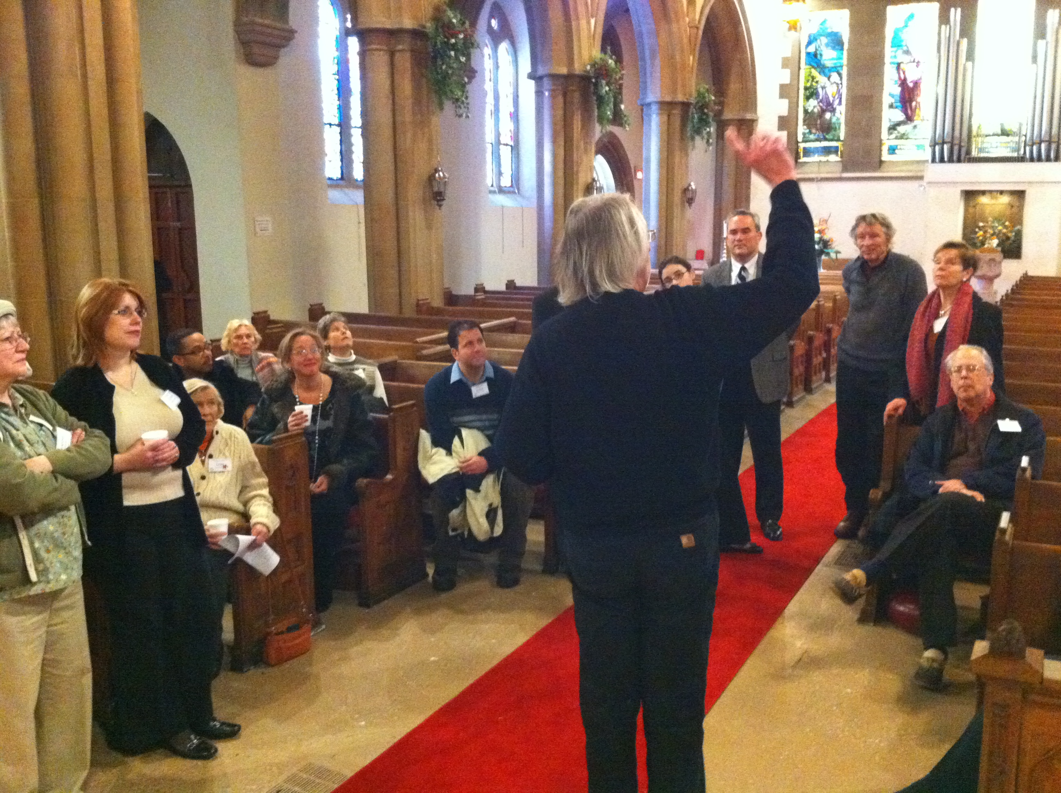
S#*!! John Says (SJS-)
Leadership is about sharing knowledge
Notes:
Don’t be afraid of it, and don’t misunderstand what it means. Leadership is not about holding on to power, but letting go of it. Look at Jesus telling the disciples to do everything he did. Leadership is about sharing knowledge not hoarding it- we are trying to share a story. Leadership is not about being the expert, but about using the experts that you have. Leadership is about listening more than speaking.

Slide 25
Stuff Jesus Says (SJS+)
Luke 11:52
‘Woe to you lawyers! For you have taken away the key of knowledge; you did not enter yourselves, and you hindered those who were entering.’

Slide 26
S#*!! John Says (SJS-)
Leadership is about letting others lead
Notes:
Don’t be afraid of it, and don’t misunderstand what it means. Leadership is not about holding on to power, but letting go of it. Look at Jesus telling the disciples to do everything he did. Leadership is about sharing knowledge not hoarding it- we are trying to share a story. Leadership is not about being the expert, but about using the experts that you have. Leadership is about listening more than speaking.

Slide 27
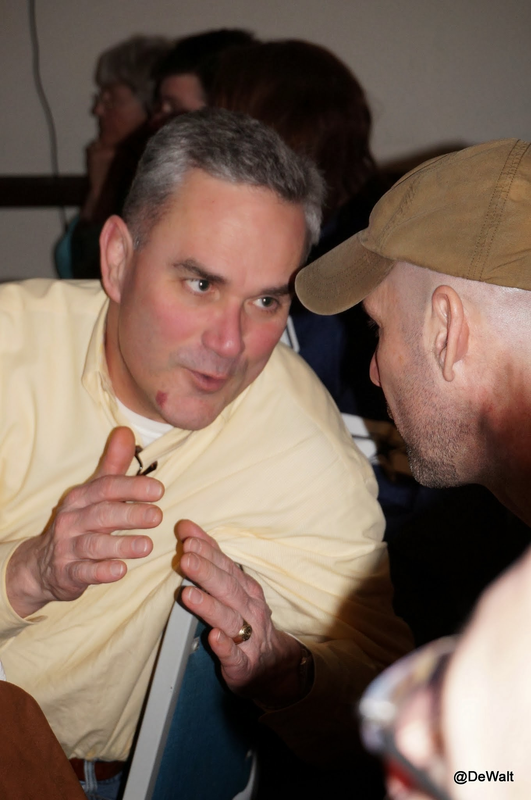
S#*!! John Says (SJS-)
Leadership is about listening
Notes:
Don’t be afraid of it, and don’t misunderstand what it means. Leadership is not about holding on to power, but letting go of it. Look at Jesus telling the disciples to do everything he did. Leadership is about sharing knowledge not hoarding it- we are trying to share a story. Leadership is not about being the expert, but about using the experts that you have. Leadership is about listening more than speaking.

Slide 28
S#*!! John Says (SJS-)
FAIL!
Notes:
Miserably, Often and Publically

Slide 29
S#*!! John Says (SJS-)
Leadership is about getting out of the way
Notes:
Don’t be afraid of it, and don’t misunderstand what it means. Leadership is not about holding on to power, but letting go of it. Look at Jesus telling the disciples to do everything he did. Leadership is about sharing knowledge not hoarding it- we are trying to share a story. Leadership is not about being the expert, but about using the experts that you have. Leadership is about listening more than speaking.

Slide 30
Stuff Jesus Says (SJS+)
Matthew 20:26
It will not be so among you; but whoever wishes to be great among you must be your servant

Slide 31
Leadership Question
Where have you seen effective leadership in your church?

Slide 32
Leadership Question
How would you lead differently in a given situation?

Slide 33
Strategic Arrangement
Leadership
for the 21st Century Church

Slide 34
Strategic Arrangement
Next generation of leaders:
Know peoples names! SJS-
Notes:
Know them. The median Episcopal Church has about 65 people coming in on a Sunday morning. The pastor should know every single one by name, and be ready to identify new folks. This takes study as much as the scripture. Remember, these people are the living Gospel. Study the directory. Pray the directory.

Slide 35
Your Slide
Who are you?
Where are you from?
Why are you here?
What do you want?

Slide 36
Strategic Arrangements
Leadership
Programs
Space
Budget

Slide 37
Program Question
What does the Church do?
Ministry Brainstorm

Slide 38
Program Question
Arrange
this work into several (~3 to 7) categories

Slide 39
Program Arrangement
Mission
Vision
Goals
Strategies

Slide 40
Mission
What do you being called to do by God?

Slide 41
Stuff Jesus Says (SJS+)
Matthew 28:19-20
‘Go therefore and make disciples of all nations, baptizing them in the name of the Father and of the Son and of the Holy Spirit, and teaching them to obey everything that I have commanded you. And remember, I am with you always, to the end of the age.’
Notes:
What other Bible verses could articulate the mission of the church?

Slide 42
Vision
What will it look like when you do it?
Notes:
A good vision comes from listening and reflecting. If the congregation can see their input reflected in vision articulated by their leader, they are more likely to support it. This involves deep listening and clear articulation. The good news is the leader doesn’t have to come up with something new, the leader just needs to say it in a new and engaging way. A good vision is not about tomorrow but about five-years from now. A longer time frame make the minutia of today disappear.

Slide 43
Goals
What are the measurable objectives?
Notes:
Numbers are not the devils handiwork as some clergy are willing to point out. If you are serious about church growth, you need to know. You also get what you measure. It keeps the focus. Everyone seems to say they want their parish to grow. Folks from growing parishes never say that the numbers are unimportant.

Slide 44
Strategies
What are the specific tasks that will be accomplished?

Slide 45
Program Arrangement
Questions for any and all programs
Where do you see God in this?
What does the Bible say about this?
How is this inviting to others?
How is this good stewardship?

Slide 46
Program Arrangement
Strategic Model
Includes Mission, Vision and Goals
Begs important questions
Structures work with vision
Delineates ministries
Identifies leaders

Slide 47
Program Arrangement

Slide 48
Program Arrangement
Pick the low hanging fruit! (SJS-)
Notes:
Low hanging fruit is simply letting people do what they want to do with the skills they have.
At my parish we have an amazing Flower Guild. They create amazing decorations for each liturgical season using flowers, fabric, candles and what ever else they can find. Only once did they ask permission. They approached me and said “We have an idea, but we wanted to run it by you first.” I immediately said “no” without even listening to their proposal. They asked why. I told them that they had never asked my permission before, so if they were that unsure it must be a bad idea. They went away laughing, and I suppose since they never told me what it was, that they probably did it anyway. But they felt empowered.
The theory here is that there are so many amazing programs out there but I feel like people long for simplicity and community. They want to try things but see the church as a big naysayer. After coffee hour one Sunday afternoon I saw some of the kids were playing Wiffle ball out on the lawn. I joined them. Over the course of a couple of weeks we had some rules for a Home Run Derby and the name SLAWB (St. Luke’s Association for Wiffle Ball) that allowed anyone to participate. We made a web page, tracked the stats and had up to date tongue-in-cheek reporting. A family that had been two-hours away with friends drove home to get to church because their sons wanted to participate. The number one league rule was that you had to receive communion that day to participate. We eventually created a Hall-of-Fame display in the rectory window (which bordered the lawn) The equipment cost five dollars but the community building was huge. It died out after about three years but the impact lingers.
What are the things that God has put in front of us that we are not ready to grab hold of and run with? Where does our arrogance make us wait in vain for something “better”?

Slide 49
Program Arrangement
Let it die(SJS-)
Notes:
There is precious little we really have to do. Be clear about that. Let people quit the leadership of an important ministry. Don’t force people into running things they have no interest in. Just let it go.

Slide 50
Program Promotion
How do you promote programs at your church?

Slide 51
Program Promotion
Answer Basic journalistic questions:
Who?
What?
When?
Where?
Why?

Slide 52
Program Promotion
Who?
“Everyone is invited”
“Y’all come?”
“Join us”
Kids
Adults
Girls
Notes:
Specify the invittion – others will want to join

Slide 53
Program Promotion
What?
“Supper”
“Reception”
“Coffee Hour”
“Bible Study”
“Youth Group”
“Formation”
Notes:
You may know what it is but how would you explain it to an alien

Slide 54
Program Promotion
When?
“Tomorrow”
“Next week”
“Tuesday”
“This afternoon”
“Every week”
“Daily”
Notes:
Make the time clickable

Slide 55
Program Promotion
Where?
Upstairs
In the church
Outside
Next door
John’s House
Lounge
Notes:
Make the location clear with directions

Slide 56
Program Promotion
Why?
Fun
Fellowship
Inspiration
Comfort
Healing
Discussion
Notes:
Answer the strategic and Biblical question

Slide 57
Church Bulletin Generator
Who | What | When | Where | Why
Everyone is invited | Supper | Tomorrow | Upstairs | Fun
Y'all come | Reception | Next Week | In the church | Fellowship
Join us | Coffee Hour | Tuesday | Outside | Inspiration
Kids | Bible Study | This afternoon | Next door | Comfort
Adults | Youth Group | Every Week | John’s House | Healing
Girls | Formation | Daily | Lounge | Discussion
Notes:
Answer the strategic and Biblical question

Slide 58
Your New Announcement
Notes:
Answer the strategic and Biblical question

Slide 59
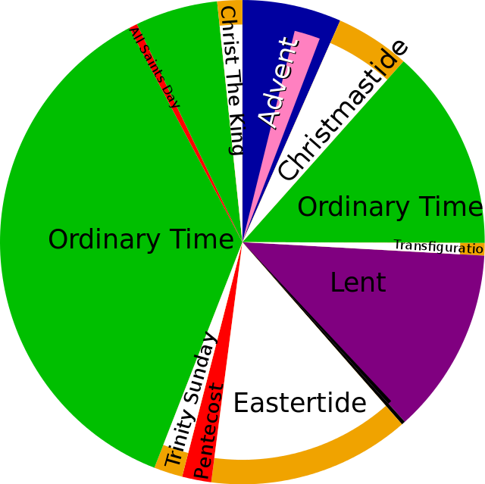
Program Arrangement
Worship
Outreach
Fellowship
Spiritual Enrichment
Youth
Music & Arts
Support

Slide 60
Program Arrangement

Slide 61
S#*!! John Says (SJS-)
Yes!!
Notes:
That is the right answer. Seminary seems to teach new clergy why to say “no”. That is not liturgically correct. That is not how Episcopalians do it. That has never been done that way. When approached with an idea, program or plan, start with “yes.” Go with the Spirit that is there. There is much more to be gained by a church that says yes, than one that says no.

Slide 62
Making Arrangements
Leadership
Programs
Space
Budget

Slide 63
Church Buildings
How do strategically align our space use to our mission and vision?

Slide 65
Stuff Jesus Says (SJS+)
John 2:19
Jesus answered them, ‘Destroy this temple, and in three days I will raise it up.’
Notes:
Jesus didn’t care about buidlings. Neither should we

Slide 66
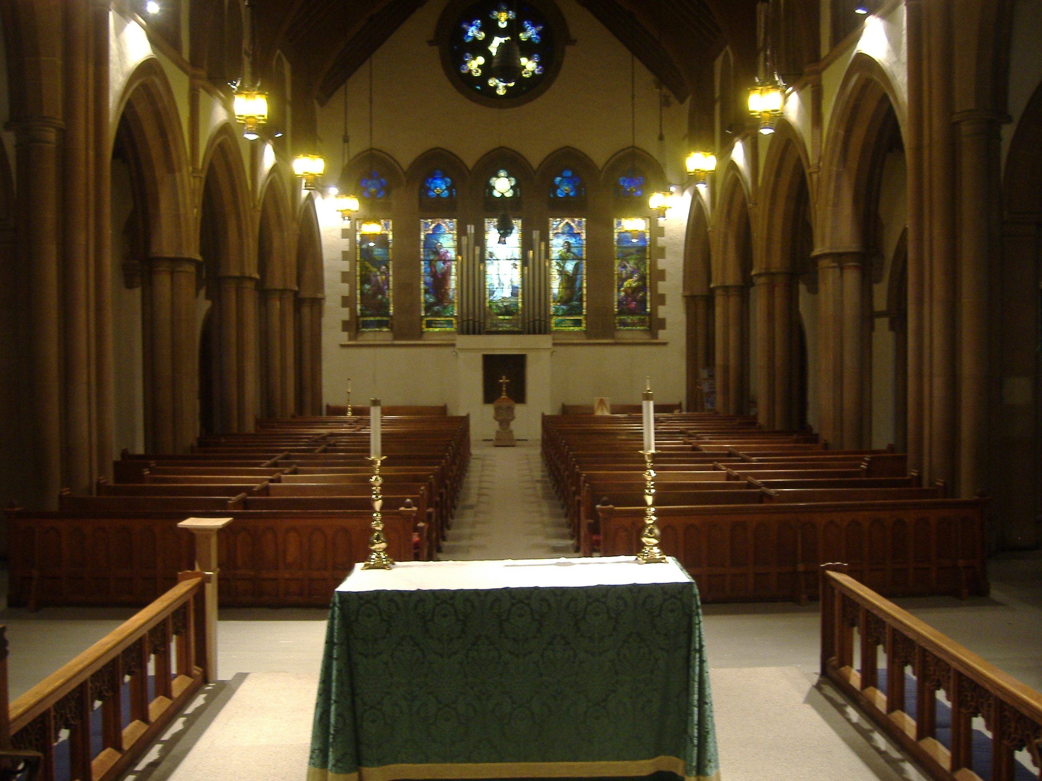
Church Buildings
Notes:
Use it or loose it. The church has way more real estate than we need. Too many buildings. Many are beautiful. But we are not running a museum. Use the spaces. Use it in ways that will wear it out. People who use a building are a lot more likely to want to help fix it. If they don’t use it, they wont care.

Slide 67
Church Buildings
Two Services on Sunday 8:00 & 10:00 (Four Hours)
2.38%

Slide 68
Church Buildings
Notes:
Use it or loose it. The church has way more real estate than we need. Too many buildings. Many are beautiful. But we are not running a museum. Use the spaces. Use it in ways that will wear it out. People who use a building are a lot more likely to want to help fix it. If they don’t use it, they wont care.

Slide 69
Space
Inside?
Outside?
Holy?
Community?

Slide 70
Space
Who are we?
Who do we want to be?
What does our mission need?
What does our vision need?

Slide 71
Making Arrangements
Leadership
Programs
Space
Budget

Slide 72
Budget
What does Jesus say about money?

Slide 73
Budget Arrangement
What does Jesus say about money?

Slide 74
Budget Arrangement
Luke 16:13
‘No slave can serve two masters; for a slave will either hate the one and love the other, or be devoted to the one and despise the other. You cannot serve God and wealth.’

Slide 75
Budget Arrangement
Matthew 6:19-21
‘Do not store up for yourselves treasures on earth, where moth and rust consume and where thieves break in and steal; but store up for yourselves treasures in heaven, where neither moth nor rust consumes and where thieves do not break in and steal. For where your treasure is, there your heart will be also.’

Slide 76
Budget Arrangement
SJS-
God will always provide enough resources for what God wants us to do, and never quite give us as much as we think we need to do what we want to do.

Slide 77
Budget Arrangement
Traditional Budget Categories
Salary
Benefits
Utilities
Insurance
Maintenance

Slide 78
Budget Arrangement
Strategic Budget Categories
Worship
Outreach
Fellowship
Spiritual Enrichment
Youth
Music & Arts

